Slide 1
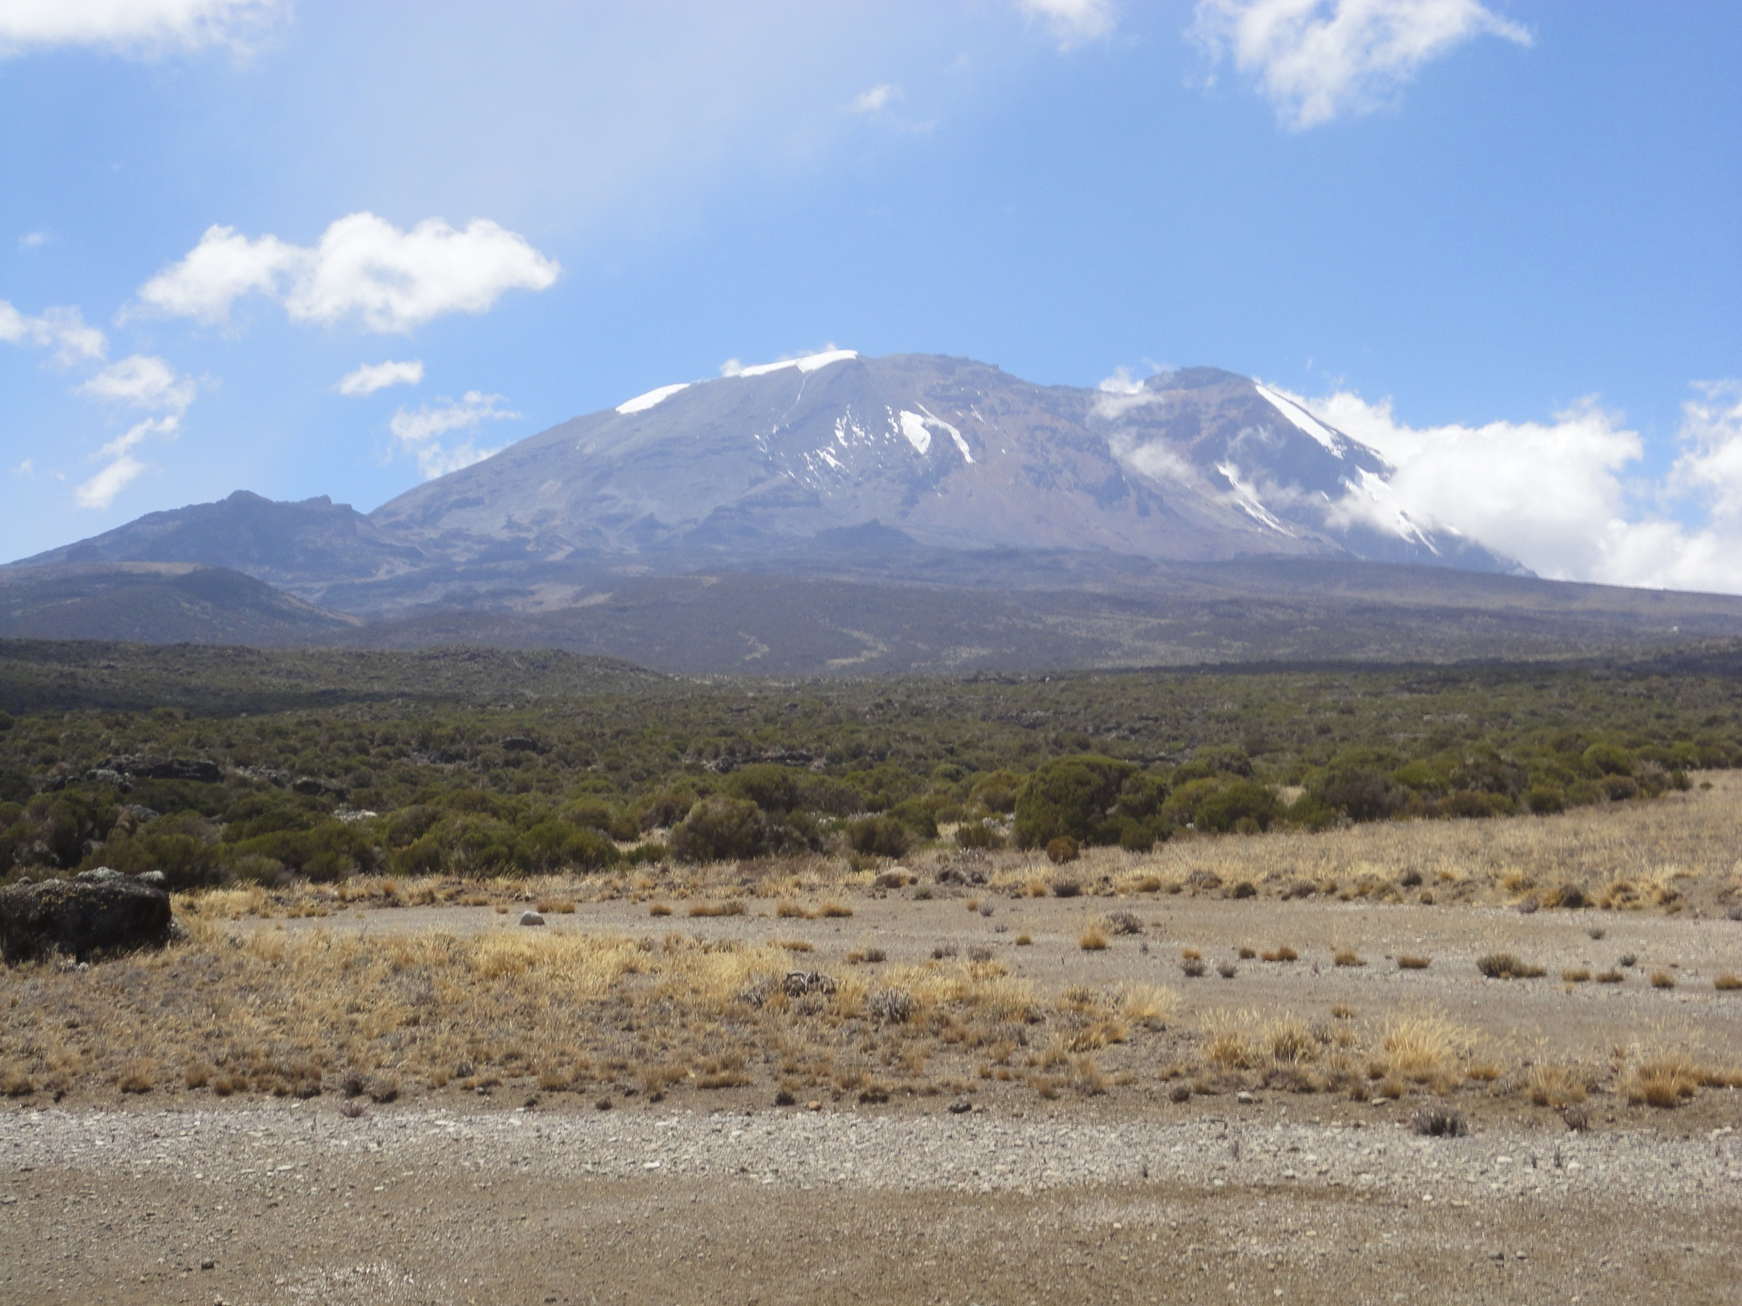

HANDLING PROCEDURES OF TOURISTS DURING THE OUTBREAK OF CORONA VIRUS (COVID – 19)
KILIMANJARO NATIONAL PARK
By: Herman Baltazary
Conservation Officer I

Slide 2
Introduction
The Park Management has set aside several measures and standard operating procedures which will ensure the safety of tourists, crews, staff and the mountain environment after the outbreak of Corona virus (COVID -19)
This document brings about procedures to be followed at entry/exit gates, camping areas, mountain huts, tourist shelters, toilets, hiking trails and rescue operations.

Slide 3
Overall Standard Operating Procedures for Mountain Climbing
All offices and points of entry/exit to have hand sterilization stations
Each staff, tourist, guide, cook and porter should wear a mask when at entry/exit gates, camping site and mountain huts;
Tour operator must sterilize all food packages with 70% alcohol solution or appropriate commercial solutions. Food items should not be mixed with other equipment;

Slide 4
Overall Standard Operating Procedures cont…
All companies should ensure that luggages are packed inside the sterilized rubberized Kitbags;
Luggage should be sprayed with sterilization solution before weighing;
All weighing to be done with rangers with appropriate PPE;
All registration entry/exit gates and mountain stations to have thermal sensor and all guests and porters / crew to be checked prior to entry;

Slide 5
Overall Standard Operating Procedures cont…
Those climbers with fevers / high temperatures / flu like symptoms will be advised to go for further medical check-up. Park reserves rights to entry;
Porters should be attended from 06:00 to 10:00hrs before visitors to allow space. Tourists should be attended from 10:00 to 15:00hrs at entry gates
All guides should wear a mask during briefing/interpretation;

Slide 6
Overall Standard Operating Procedures cont…
Tour operators/Guide to hand/provide a registered hardcopy list of names for climbers at point of entry and mountain stations;
All climbers to wash their hands upon arrival to the camp before proceeding in the designated zone/location;
All tour operators should ensure masks and disposable gloves are provided to crews and also should provide special trash bags/containers recommended to keep such wastes;

Slide 7
Overall Standard Operating Procedures cont…
Where appropriate one cook and one waiter should be allowed in kitchen tent;
Each tour operator should encourage tourist to use private toilets;
Each tour climber should have sanitizer to disinfect the toilet along the trail and in main scrambling routes;
Each climber should have a portable sanitizer for personal use;

Slide 8
Overall Standard Operating Procedures cont…
All climbers must maintain a social distance of more than one and half meters at all eating spots (picnic sites, dinning) and while walking on a trail;
Anyone with symptoms should be requested to descend immediately with appropriate support and close monitoring.

Slide 9
Specific SOPs - Entry gates
Well demarcated standing marks should be in place on areas that service require queuing;
For day hikes mobile mode of payment should be adhered and if payment is done by a card all hygienic measures should be applied to POS machines and the card;
Permits should be printed after completion of temperature check process;
Tour operators should ensure payments and personal particulars are well prepared in advance

Slide 10
Specific SOPs - Exit gates
Unnecessary social gatherings are strictly prohibited (Neither cheering nor singing);
Cooking of food at exit gates should not be allowed;
Re-supply will only be allowed to Mweka huts, High Camp, Karanga camp, Barafu, Horombo, Kibo, Mawenzi tan hut and school hut;
To avoid delay at exit gates tour operators with extra days should ensure that correct payment is done before the visitor arrives at the gate.

Slide 11
Specific SOPs – Weighing point
Luggage packing and weighing exercise should be done by the tour operators before arrival to Park entry points. Sorting and rearrangement of luggage’s are strictly prohibited at park entry points;
Luggage may be opened if there is a need to do so;
Guides/Tour operators/Porters should declare items carried in their luggage;
All luggage’s should be sprayed with recommended disinfectant while at the entry point.

Slide 12
Specific SOPs – Camping sites
Pitching of tents should maintain a distance of two meters between groups of different companies;
Each climber should occupy one tent with exception to families and couples;
Camping equipment should be sterilized/disinfected;
Porters should avoid unnecessary movements and gatherings (neither singing nor playing games).
Overcrowding in sleeping tents by porters and guides should be avoided in camping routes

Slide 13
Specific SOPs – Mountain Huts
Porters should maintain social distance of one meter and half from one another when in their huts;
Keys should be disinfected and placed on the door locks;
Tour operators should provide private toilets to minimize use of public toilets;
Distance of two meters should be maintained between groups of different companies when cooking in the kitchens;

Slide 14
Specific SOPs – Mountain Huts cont…
Disinfection of the hut walls, furniture and other equipment will be thoroughly conducted after checkout of guests;
Porters should avoid unnecessary movements and gatherings (neither singing nor playing games).

Slide 15
  Specific SOPs – Tourists and Porters Shelters
Wash their hands with soap;
Sanitize;
Wear mask;
Maintain social distance of more than one meter.

Slide 16
  Guiding services
All guides should ensure that all group members adhere to mountain standard operating procedures

Slide 17
  Rescue operations
The rescue staff should wear PPE when attending patient;
Rescue vehicle should be disinfected before and after rescuing a patient;
Each vehicle should be equipped with all necessary first aid kits;
Patients in the rescuing vehicle should not be mixed with other climbers

Slide 18
Rescue operations cont…
The park should ensure there is enough first aid kits in each mountain station
The park to encourage tour operators to carry extra oxygen cylinders
Only patient daypack should be allowed in rescue vehicle
Patient registration at exit gates should be done by the park ranger

Slide 19
…….End………….
Ahsaste
Na
Karibuni!

